Slide 1
Singular Value Decomposition
Itay Hazan

Slide 2
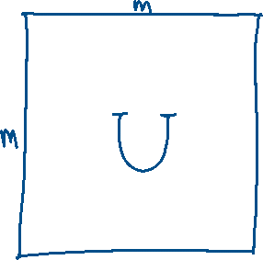


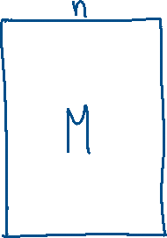

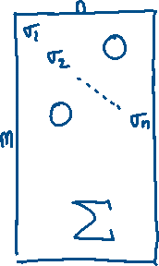



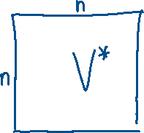


Claim.

Slide 3

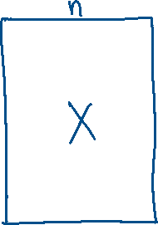

Slide 4




Slide 5



Slide 6
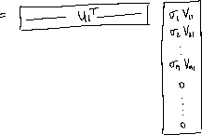

Slide 7


Slide 8



Slide 9
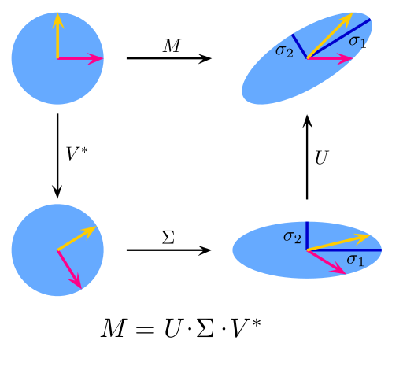
Visualization of SVD

Slide 10
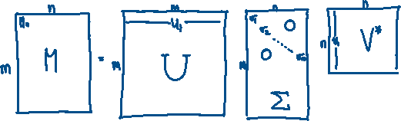
Using SVD for Dimension Reduction

Slide 11


















Using SVD for Dimension Reduction

Slide 12
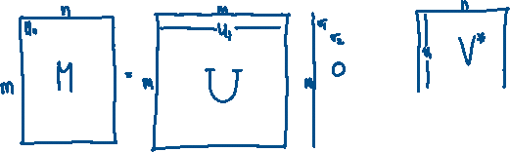


Using SVD for Dimension Reduction

